Slide 1
BeMinimalist
(tentative)
Proposal
Skincare Brand
- Narmatha T

Slide 2
Skin Care Market
The India skin care products market size was valued at $2,478.4 million in 2017, and is projected reach $5,033.7 million by 2027, registering a CAGR of 9.5% from 2021 to 2027.
Founded in 2020, Minimalist is a skincare brand that is gaining popularity rapidly due to its innovative and honest approach. Synonymous with Transparent Beauty, the brand has a wide range of products that target various skin types. Minimalist is said to be transparent in terms of the ingredients that they use in their products. Their aim is to create clean products.
(Estimate by Allied Market Research)

Slide 3
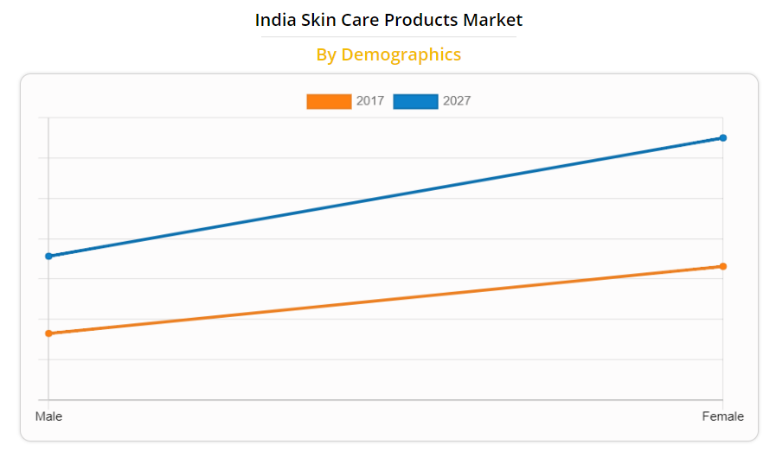
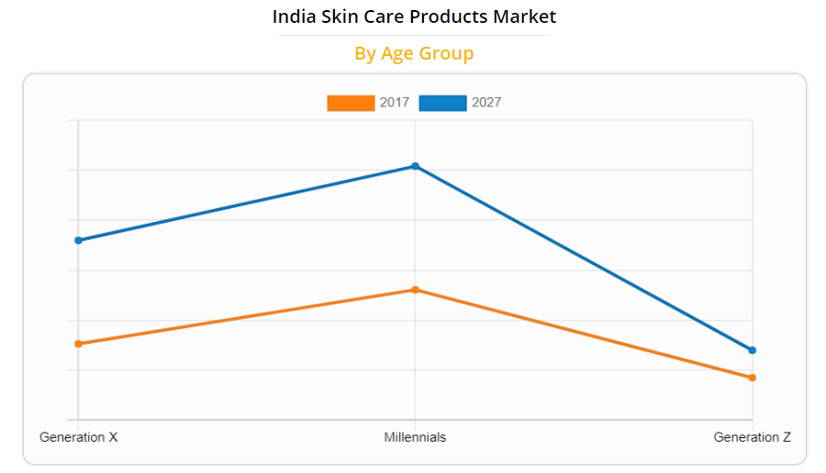
Trends and Forecast of Skin Care Market (Reference Materials)

Slide 4
Minimalist Co.
Having a portfolio of diverse skincare and hair care products, the brand retails through its own website, along with e-commerce giants like Amazon, Nykaa, Flipkart, Myntra, and numerous other marketplaces. Minimalist currently offers 20 products ranging from serums, toners, face acids, and moisturizers. The company said their products are well researched, backed by proven science, safe, effective, mindfully created, and suited for all skin types.
So far, Minimalist has served over 1 million customers. The firm said its products are popular among both women and men looking for solutions to acne, pigmentation, excess sebum and dull skin.
They popped up in the market as a made-in-India version of The Ordinary but have grown to include ingredients and products suitable for our skin at a good price point.

Slide 5
Skin Care Market
From a generic point of view, a typical cosmetics business dealing in make-up items and other skincare products will primarily have women, aged 18 and above as its target market.
Skin care was the most shopped-for beauty category across all age groups. The majority of Gen Z shoppers (aged 18 to 24 years) said skin care was the product category they currently spend the most on.
Showcase your customer reviews. Advertising skincare products gets so much easier when consumers are saying great things about your brand. That's why you should reach out to your loyal fans to get product reviews. Use those testimonials on your website and ads, post them on your social media accounts.
The ideal age to start using face serums would be late 20s and early 30s. This is the age at which the first signs of aging appears. You can continue using face serums till the age of 50+. Including a face serum in your skincare regimen will not only enhance your skin but also protect it.

Slide 6
Challenges faced by Minimalist
People do not have the knowledge of which product is suitable for them and works the best on them. Greenwashing is marketing strategy used by companies to position themselves in the minds of consumers as an environmentally friendly brand/product. In this way, companies exaggerate their claims or the benefits regarding environmental issues in an attempt to mislead consumers. This is hugely disadvantageous to clean brands.
The skincare products market is highly competitive, with the top global and regional players competing fiercely to garner market share. Also, Customers look cruelty-free companies and eco-friendly products that does not harm the nature.
Quality, Efficacy, and Trust of the Customers is most important. As a starter in the beauty industry, it is important to build the bond with the customers by Social Media Marketing, doing Giveaways,distribute to Local Stores, make Use of Influencers, get Testimonials from Your Customers, put Your Products Online.
To Compete with other beauty brands, it is essential to have a unique user friendly website which uses technology(Computer Vision, Deep Learning,etc) for its customers benefit to understand their skin and recommend products that works best for their skin types.

Slide 7
Attracting wide range of Age groups
Male and Female customers of age from 18 to 50+ by social platforms and awareness.
MAIN CAUSES
AGE
55%
45%
Cosmetics
Stress
TYPES OF ACNE
Skin ticks
Medicine
Blackhead
Papule
Pustule

Slide 8
Knowing your Skin!
CAUSES
TREATMENT
You're shedding skin cells throughout the day, so it's important to keep your skin glowing and in good condition.
An effective routine can help prevent acne, treat wrinkles, and help keep your skin looking its best.
Cosmetics
Stress
Antibiotics
Diet
Medicine
Genetics
Laser
Cleansing

Slide 9
Ordering Procedure 1 : Skin Survey
Personal Details
Skin Analysis
Name, Age Gender
1
6
Wrinkles, Sagging, Dry Patches, Eczemas
Concern
Medications
2
5
Acne, Blemishes, Issues
Steroids, Tretinols, Hydroquinone, Pregnant, Breast Feeding,
Skin Type
3
4
Skin Texture
Normal, Dry, Oily, Combination
Skin reaction to products, Skin turns reddish with temperature,

Slide 10
Skin Types
Normal skin
Dry skin
Oily skin
Combination skin
Sensitive skin

Slide 11
Skin Causes
TYPES
CAUSES
Blackhead
Hormones
Whitehead
Menstrual cycle
Papule
Cosmetics
Pustule
Diet

Slide 12
Ordering Procedure 2 : Automatic Facial Skin Feature Detection for Everyone
Accurate analysis of skin status, such as skin color, skin type, double eyelids, eye pouch, dark circles, wrinkles, acne and skin spots.
An automatic facial skin defects detection and recognition method is proposed using deep learning and Computer Vision. The system first locates the facial region from the input image. Then, the shapes of faces were recognized using a contour descriptor. The facial features are extracted to define regions of interest and an image segment method is used to extract potential defect. A support-vector-machine-based classifier is then used to classify the potential defects into spots, acnes and normal skin.

Slide 13
Ordering Procedure 3 : Products Recommendation
Product Suggestions
Products are chosen according to your Skin Survey and analysis along with other similar products that work best for your skin. Enter your contact details and delivery location information.
Now order will be delivered to you on the date of delivery.
Normal
Oily
Dry
Combination
Treatment and prevention
1
2
3
4
5

Slide 14
Product Recommendation Based on the Skin Analysis
Exfoliate
Essence
Facemask
Face cream
Cleanse
Toning
Serum
Eye cream

Slide 15
Customer Reviews Page
Reviews not only have the power to influence consumer decisions but can strengthen a company's credibility. Reviews have the power to gain customer trust, and they encourage people to interact with the company. Customer interaction ultimately leads to improved profits for businesses.
Reviews Generate More Reviews - When a business has already received
online reviews, it encourages other visitors to leave their own feedback.
Consumers that take the time to leave an online review for your business are far more likely to feel a certain loyalty to you and keep coming back.
Reviews enable new businesses to stand shoulder to shoulder with more established competition

Slide 16
Customer Reviews Page
4.5/5 Ratings
Tanaka
3/5 Ratings
Teru
Very much pocket friendly, suitable for absolute sensitive skin and visible results.
Good product. Takes a lot of time to see changes.
5/5 Ratings
Hinata
Yamada
4/5 Ratings
The one and only skincare product that actually worked on my skin!! Very effective, shows improvement, budget friendly, gentle on skin.
My life saviour i.e. I can say my skin saviour. I started seeing the effect after 2 months and now it's doing wonders.

Slide 17
Development Schedule
Developing the UI design for the Skin Survey with several questions regarding the customers skin for the analysis.
3-4 weeks
Designing the best algorithm to use for the Skin analysis using real time camera using machine learning models and Computer Vision.
5-6 weeks
Training and testing the model with datasets for most accurate results.
1-2 weeks
Development of Customer Reviews Page
2-3 weeks
Testing
3-4 weeks

Slide 18
Thank You!
Have a plump, youthful and healthy looking skin.
Do Visit:
https://beminimalist.co/

